Slide 1
AN APPROACH FOR PREDICTION OF GLOBAL TERRORISM BY USING MACHINE LEARNING
Guided by:- Dr.Y.Md.Riyazuddin
221710310037 M.Laxmi Prasanna
221710310043 M.RangaBhagavan Reddy
221710310057 Rayapudi Krishna Chaithanya
221710310048 Namburi Rohith Reddy

Slide 2
CONTENTS
ABSTRACT
PROBLEM STATEMENT
DATA SET
SYSTEM STUDY
SYSTEM ARCHITECHURE
FUNCTUNAL REQUIRMENTS
FEASIBILITY STUDY
ALGORITHMS USED
REQUIREMENT ANALSYS
REQUIRMENT SPECIFICATION
CONCLUSION

Slide 3
ABSTARCT
The objective of this work is to predict the region and country of a terrorist attack using machine learning approaches. The work has been carried out upon the Global Terrorism Database (GTD), which is an open database containing list of terrorist activities from 1970 to 2017. Five machine learning algorithms have been applied on a selected set of features from the dataset to achieve an accuracy of up to 90%.
The results suggest that it is possible to train machine learning models in order to predict the region and country of terrorist attack if certain parameters are known. It is postulated that the work can be used for enhancing security against terrorist attacks

Slide 4
PROBLEM STATEMENT
Terrorism isn’t limited to one group, geographic area, grievance, goal, method, or era. For the last century, terrorists have committed violence for all kinds of reasons: to create a new country, carry out a revolution, achieve racist goals, free animals from laboratory testing, end abortion, and more.
Analyzing terrorist groups, where they come from, why they form, and what they hope to achieve, is the first step toward combating them.
we take various approaches to categorizing and analyzing groups to recognize patterns of behavior, locate geographic hotspots and potential targets, and understand the evolution of groups over time. so we use Machine learning algorithm to predict the terrorism.

Slide 5
DATA SET
The Global Terrorism Database (GTD) is a database of incidents of terrorism from 1970 onward. As of July 2017, the list extended through 2016, with an incomplete data of 1993 due to issues with that year.
The GTD describe itself as the "most comprehensive unclassified data base on terrorist events in the world" and includes over 190,000 terrorist attacks in 2019 version. The entire database (about 80 MB excel file and 9 MB Geodatabase file) is available for download via the website.[The GTD includes more than 83,000 bombings . It also includes more than 18000 assassinations and more than 11000 kidnappings.

Slide 6
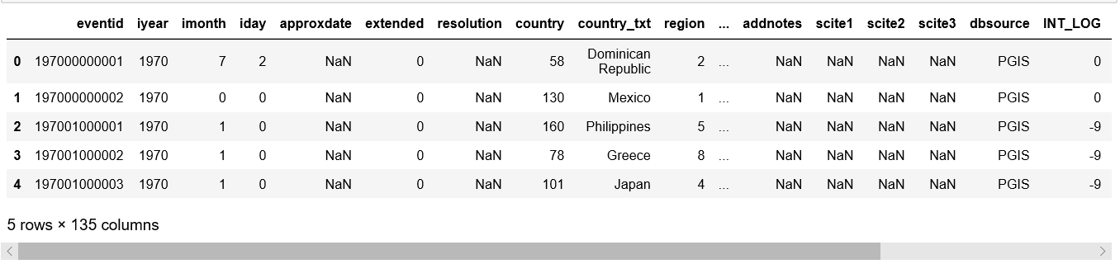
The data set contains the following data:
Country , State, City, Region, latitude and longitude.
Year , Month, Date
Weapons type
Property loss
Targets

Slide 7
SYSTEM STUDY
EXISTING SYSTEM:
In existing system we are analysing the terrorism attacks but we don’t know the how the attack will be happened where it will be happening and who will do etc. By using proposed system we can identify which year, month attack will be happened and who will be attacked etc. We can analyse the better accuracy by using machine learning algorithms.
DISADVANTAGES OF EXISTING SYSTEM:
By using confusion matrix we got the accuracy, that will be based on TRUE POSITIVE and TRUE NEGATIVE.so if the result falls in FALSE POSITIVE and FALSE NEGATIVE. then our prediction will be false.

Slide 8
PROPOSED SYSTEM:
It provides an approach to analysing terrorism region and country with the machine learning techniques and terrorism specific knowledge to fetch conclusions about terrorist behaviour patterns based on the success or failure.
ADVANTGES OF PROPOSED SYSTEM:
By increasing the accuracy It is postulated that the work can be used for enhancing security against terrorist attacks in the world.
This helps the anti-terrorist organizations to reduce the list of possible suspects and help them act rapidly to find and catch the real suspect

Slide 9
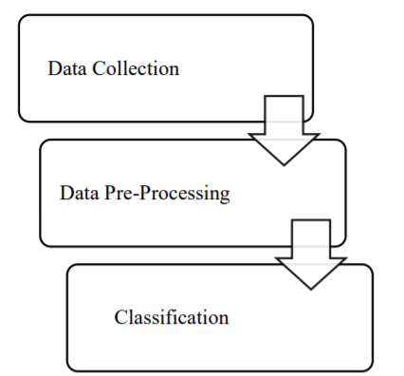
SYSTEM ARCHICETURE

Slide 10
FUNCTIONAL REQUIREMENTS
DATA COLLECTION
The data collection process involves the selection of quality data for analysis. Here we used ,GTD.
The GTD holds 180000 data assaults by terrorists having more than 40 factors for every occurrence, that made this dataset as "right now finest exhaustive unsorted information dependent upon psychological militant occasions on the planet.
DATA VISUALIZATION
A large amount of information represented in graphic form is easier to understand and analyze. Some companies specify that a data analyst must know how to create slides, diagrams, charts, and templates. In our approach, the all the questions are visualized in graphical format for better viewing.

Slide 11
FEASIBILITY STUDY
The feasibility of the project is analyzed in this phase and business proposal is put forth with a very general plan for the project and some cost estimates. During system analysis the feasibility study of the proposed system is to be carried out. This is to ensure that the proposed system is not a burden to the company. For feasibility analysis, some understanding of the major requirements for the system is essential.
ECONOMICAL FEASIBILITY
TECHNICAL FEASIBILITY
SOCIAL FEASIBILITY

Slide 12
ECONOMICAL FEASIBILITY
This study is carried out to check the economic impact that the system will have on the organization. The amount of fund that the company can pour into the research and development of the system is limited. The expenditures must be justified. Thus the developed system as well within the budget and this was achieved because most of the technologies used are freely available. Only the customized products had to be purchased.

Slide 13
TECHNICAL FEASIBILITY
This study is carried out to check the technical feasibility, that is, the technical requirements of the system. Any system developed must not have a high demand on the available technical resources. This will lead to high demands on the available technical resources. This will lead to high demands being placed on the client. The developed system must have a modest requirement, as only minimal or null changes are required for implementing this system.

Slide 14
SOCIAL FEASIBILITY
The aspect of study is to check the level of acceptance of the system by the user. This includes the process of training the user to use the system efficiently. The user must not feel threatened by the system, instead must accept it as a necessity. The level of acceptance by the users solely depends on the methods that are employed to educate the user about the system and to make him familiar with it. His level of confidence must be raised so that he is also able to make some constructive criticism, which is welcomed, as he is the final user of the system.

Slide 15
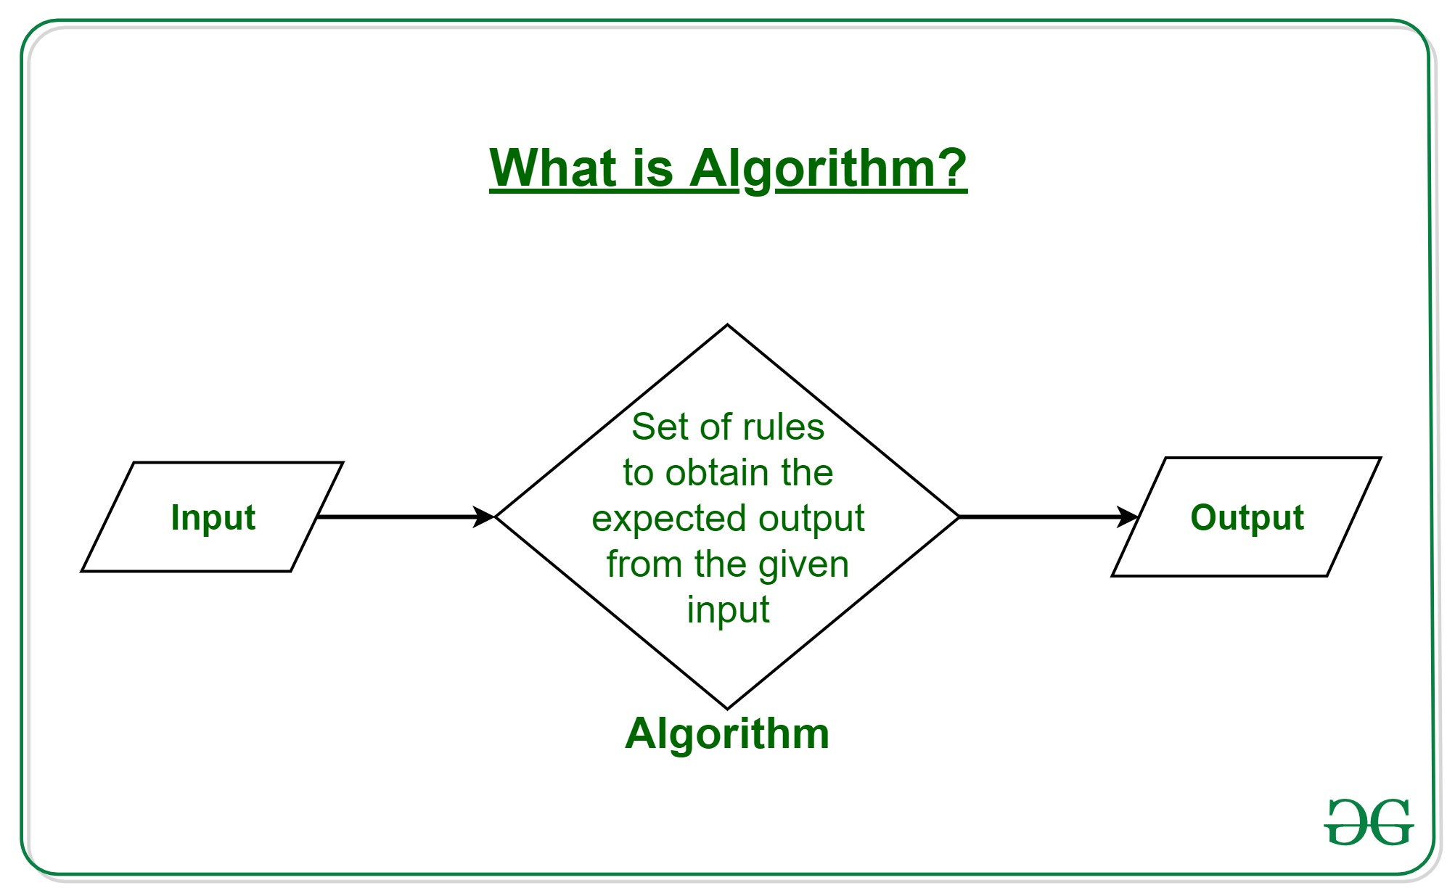
ALGORITHMS USED
Logistic regression
K- Nearest Neighbors
Linear Discriminant Analysis (LDA)
Decision tree
Support vector machine (SVM)

Slide 16
Logistic Regression
Logistic regression is a supervised learning classification algorithm used to predict the probability of a target variable. The nature of target or dependent variable is dichotomous, which means there would be only two possible classes.
In simple words, the dependent variable is binary in nature having data coded as either 1 (stands for success/yes) or 0 (stands for failure/no).
Mathematically, a logistic regression model predicts P(Y=1) as a function of X. It is one of the simplest ML algorithms that can be used for various classification problems such as spam detection, Diabetes prediction, cancer detection etc.

Slide 17
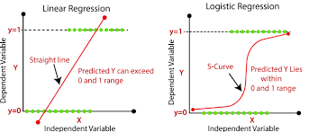

Slide 18
K- Nearest Neighbors
K-Nearest Neighbour is one of the simplest Machine Learning algorithms based on Supervised Learning technique. ... KNN algorithm at the training phase just stores the dataset and when it gets new data, then it classifies that data into a category that is much similar to the new data.
Steps to implement the K-NN algorithm:
Data Pre-processing step
Fitting the K-NN algorithm to the Training set
Predicting the test result
Test accuracy of the result(Creation of Confusion matrix)
Visualizing the test set result.

Slide 19
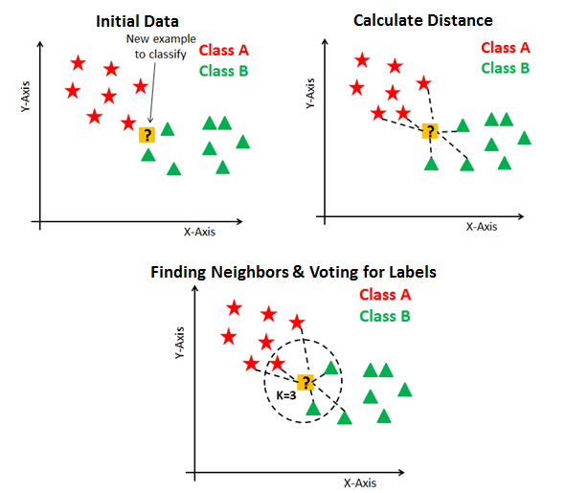

Slide 20
Linear Discriminant Analysis
Linear discriminant analysis (LDA), normal discriminant analysis (NDA), or discriminant function analysis is a generalization of Fisher's linear discriminant, a method used in statistics, pattern recognition, and other fields, to find a linear combination of features that characterizes or separates two or more classes of objects or events.
The limitations of logistic regression and the need for linear discriminant analysis.
The representation of the model that is learned from data and can be saved to file.
How the model is estimated from your data.
How to make predictions from a learned LDA model.
How to prepare your data to get the most from the LDA model.

Slide 21
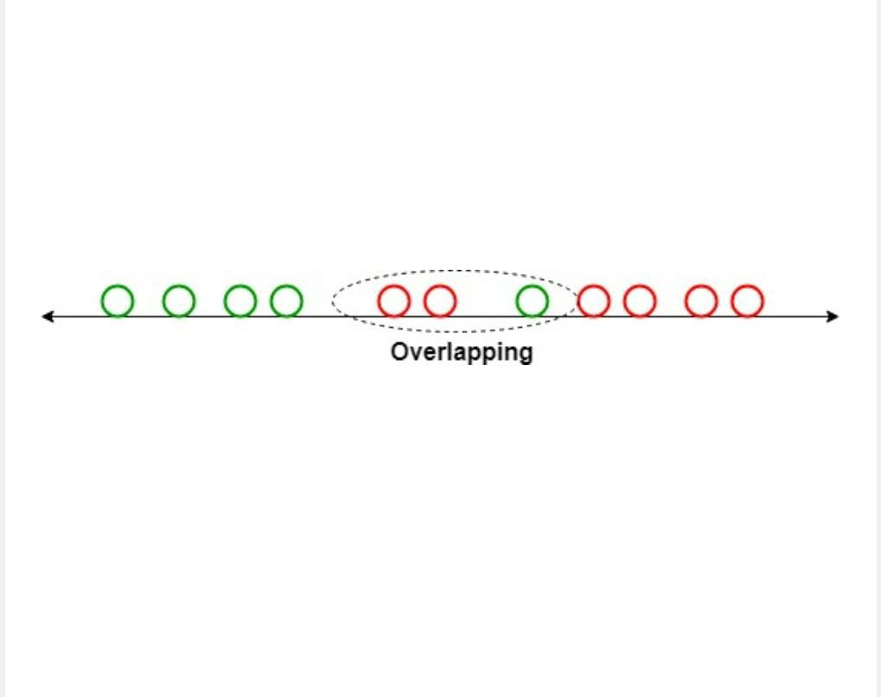
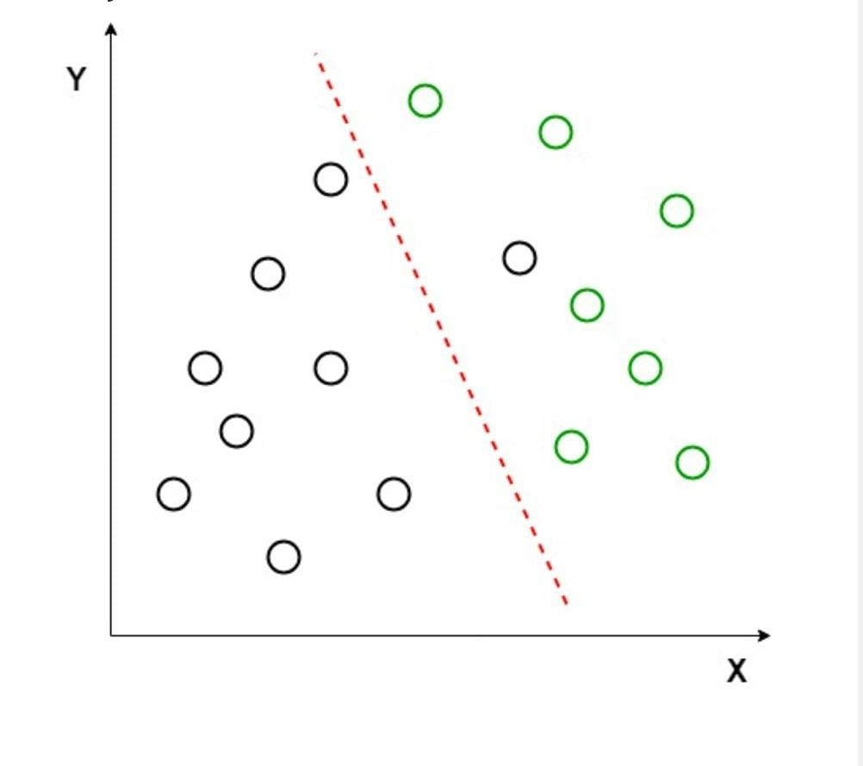
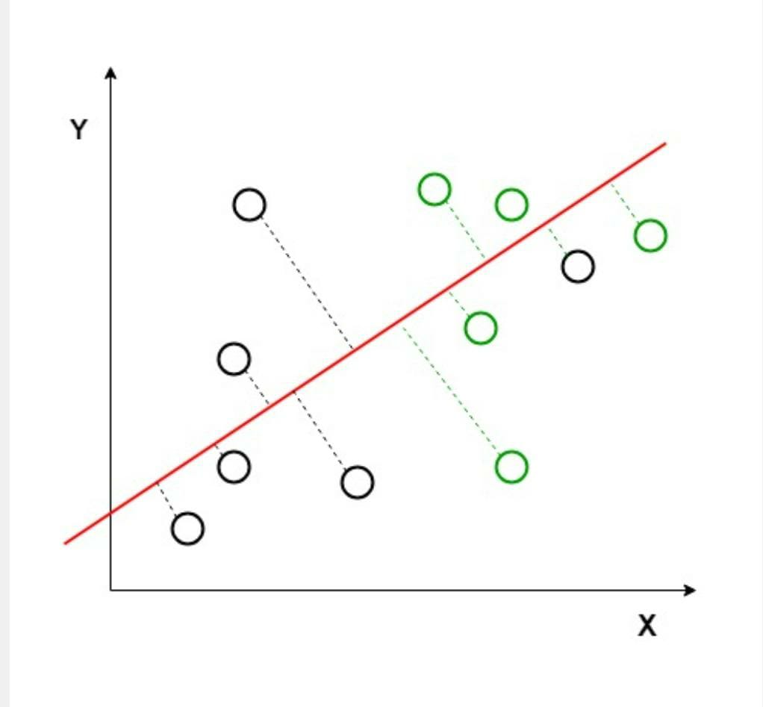
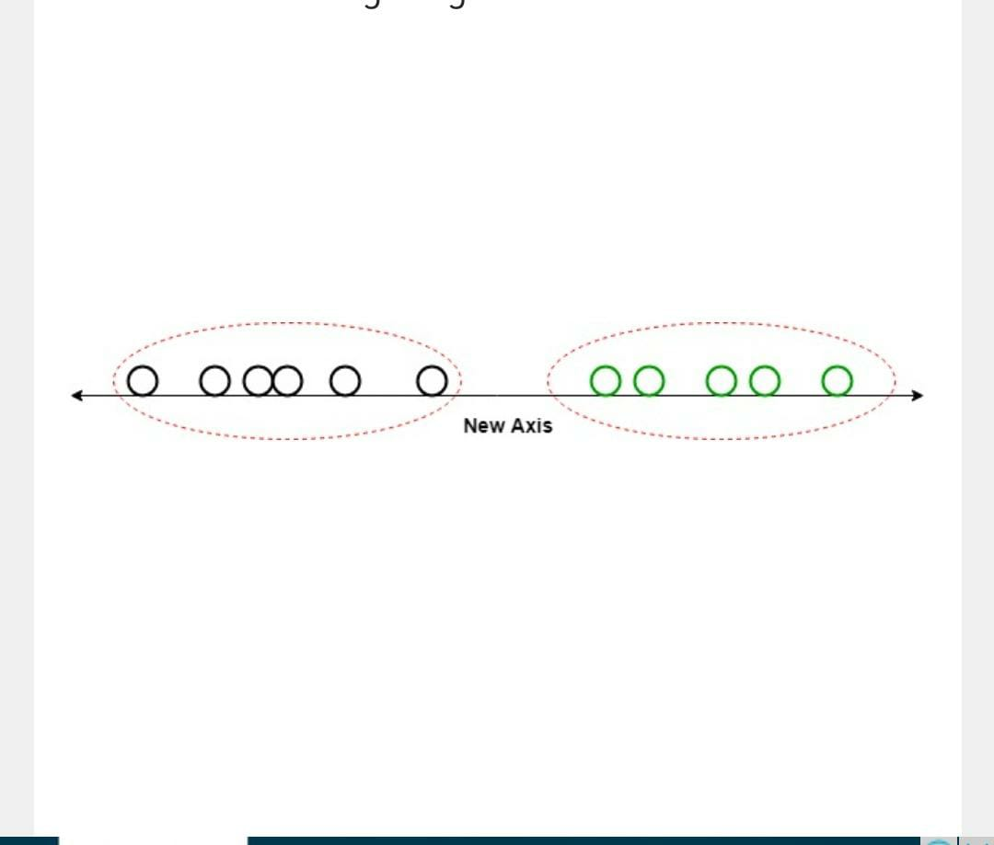

Slide 22
Decision tree
Introduction Decision Trees are a type of Supervised Machine Learning (that is you explain what the input is and what the corresponding output is in the training data) where the data is continuously split according to a certain parameter. The tree can be explained by two entities, namely decision nodes and leaves.
Supervised learning method used for both classification and regression tasks. The goal is to create a model that predicts the value of a target variable by learning simple decision rules inferred from the data features.

Slide 23

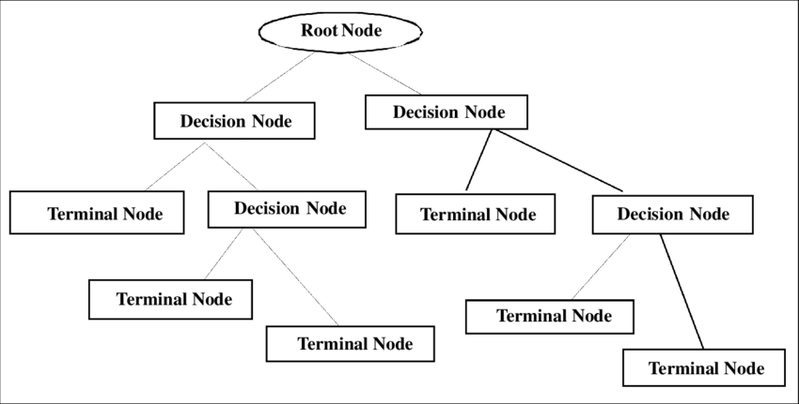

Slide 24
Support Vector Machines
In machine learning, support-vector machines are supervised learning models with associated learning algorithms that analyze data for classification and regression analysis
SVM is a supervised machine learning algorithm which can be used for classification or regression problems. It uses a technique called the kernel trick to transform your data and then based on these transformations it finds an optimal boundary between the possible outputs.

Slide 25
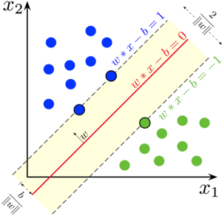

Slide 26
Requirement Analysis
The project involved analyzing the design of few applications so as to make the application more users friendly. To do so, it was really important to keep the navigations from one screen to the other well ordered and at the same time reducing the amount of typing the user needs to do. In order to make the application more accessible, the browser version had to be chosen so that it is compatible with most of the Browsers.

Slide 27
REQUIREMENT SPECIFICATION
Functional Requirements
Graphical User interface with the User.
Software Requirements
For developing the application the following are the Software Requirements:
Python
Anaconda3(Jupyter Notebook)
Operating Systems supported
Windows 7
Windows XP
Windows 8

Slide 28
Technologies and Languages used to Develop
Python
Debugger and Emulator
Any Browser (Particularly Chrome)
Hardware Requirements
For developing the application the following are the Hardware Requirements:
Processor: Pentium IV or higher
RAM: 256 MB
Space on Hard Disk: minimum 512MB

Slide 29
CONCLUSION
After training our models on the variables month, Traget_type, attack_type to predict the region of attack and country of attack it is estimated that Logistic regression got higher accuracy of 90 % in both the cases on predicting Region and country of terrorist attack. The results of the presented work can be used for enhancing defense against terrorist attacks in coming times

Slide 30


Slide 31
THANK YOU

